Slide 1
Xiaowen Tang¹, Andres Kaufmann², Charlotte Skriver³, Nicolaj Toft⁴ ¹ Una Health, Germany, ² University of Copenhagen, Denmark, ³ Danish Cancer Society Research Center, Denmark, ⁴ University of Southern Denmark, Denmark
Exploring bias in a neural network-based model
predicting myocardial infarction (MI)
from electrocardiograms (ECGs)

Slide 2
Introduction
Deep learing algoritms evaluating ECGs could improve clinical practice
➔ bias and fairness of algorithms!
Patient body mass index (BMI) has been shown to influence ECG characteristics
➔ affect diagnostic performance of algorithms?
Aim
Neural network model using 12-lead ECGs
MI
BMI
Notes:
Deep learing algoritms evaluating ECGs have the potential for improving clinical practice, but bias and fairness of algorithms needs to be examined closely.
Patient BMI has been shown to influence ECG characteristics, and could perhaps affect diagnostic performance of deap learning algorithms.
Aim
To explore if patient BMI influences the performance of a neural network model predicting MI from ECGs.

Slide 3
Material and Methods
Data
PTB-XL ECG dataset: 21,837 clinical 12-lead ECGs from 18,885 patients of 10 sec. length.
Methods
We trained a neural network model based on 12-lead ECGs with MI annotation and assessed model performance within three WHO defined BMI categories:
<25.0 Underweight/normal
25.0–29.9 Pre-obesity
≥30.0 Obesity
Notes:
Deep learing algoritms evaluating ECGs have the potential for improving clinical practice, but bias and fairness of algorithms needs to be examined closely.
Patient BMI has been shown to influence ECG characteristics, and could perhaps affect diagnostic performance of deap learning algorithms.
Aim
To explore if patient BMI influences the performance of a neural network model predicting MI from ECGs.

Slide 4
Material and Methods
Neural network model
We converted the 12-lead ECGs into images
We adapted the resnet_18 from Pytorch's official implementation
First layer was changed to accept a single channel 2D input. (instead of 3 channel image data.)
Notes:
Deep learing algoritms evaluating ECGs have the potential for improving clinical practice, but bias and fairness of algorithms needs to be examined closely.
Patient BMI has been shown to influeA common way to use convolutional neural networks for ECG training is to use 1D convolution kernels. The difference between conv1d layer and conv2d layer is visualized below, conv2d layer is able to extract the internal and inter-lead features of the 12-lead ECG.
nce ECG characteristics, and could perhaps affect diagnostic performance of deap learning algorithms.
Aim
To explore if patient BMI influences the performance of a neural network model predicting MI from ECGs.

Slide 5
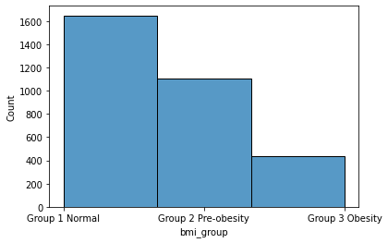
Material and Methods
Experiments: We ran two experiments.
Experiment 1:
Training dataset: All patients with MI annotations,excluding the test dataset (n=x)
Test dataset: Patients with BMI values, 128 from each group.
Experiment 2:
Training dataset: Patients with BMI values, 320 from each group.
Test dataset: Patients with BMI values, 64 from each group.
Notes:
Deep learing algoritms evaluating ECGs have the potential for improving clinical practice, but bias and fairness of algorithms needs to be examined closely.
Patient BMI has been shown to influence ECG characteristics, and could perhaps affect diagnostic performance of deap learning algorithms.
Aim
To explore if patient BMI influences the performance of a neural network model predicting MI from ECGs.

Slide 6
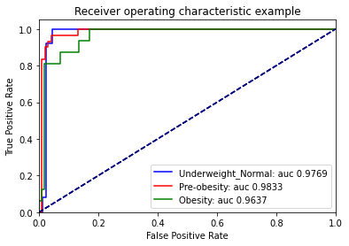
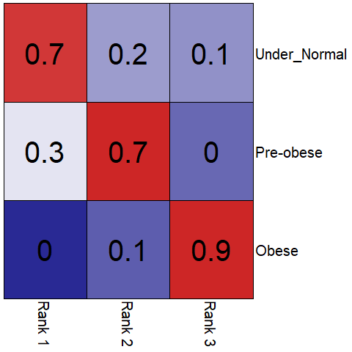
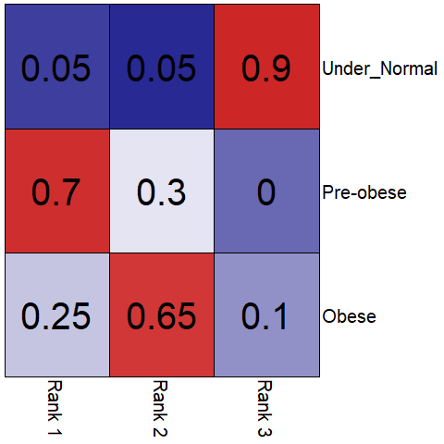
Results
Model performance Experiment 1 Experiment 2
Notes:
Deep learing algoritms evaluating ECGs have the potential for improving clinical practice, but bias and fairness of algorithms needs to be examined closely.
Patient BMI has been shown to influence ECG characteristics, and could perhaps affect diagnostic performance of deap learning algorithms.
Aim
To explore if patient BMI influences the performance of a neural network model predicting MI from ECGs.

Slide 7
Discussion
Important to consider the distribution of characteristics in the training set.
Overall the model perfomed well irrespective of BMI.
Correcting for the sample size in each group did not completely remove bias in the analysis.
Considering bias in a neural network model should be standard practice.
Notes:
Deep learing algoritms evaluating ECGs have the potential for improving clinical practice, but bias and fairness of algorithms needs to be examined closely.
Patient BMI has been shown to influence ECG characteristics, and could perhaps affect diagnostic performance of deap learning algorithms.
Aim
To explore if patient BMI influences the performance of a neural network model predicting MI from ECGs.

